Slide 1
Ethics

Slide 2
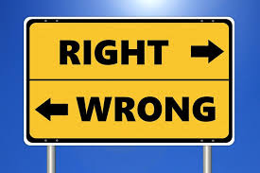
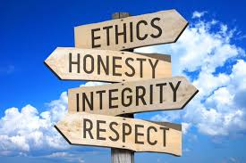
The Language of Ethics

Slide 3
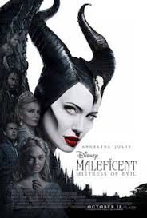
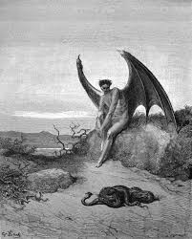
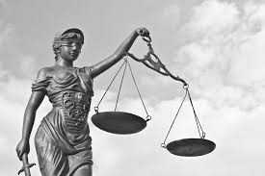
Good and Evil. Justice, Fairness and Equity

Slide 4
Ultimatum and Schadenfreude

Slide 5
Ultimatum Game
https://www.youtube.com/watch?v=S_q7CqElaSk
https://www.youtube.com/watch?v=_MgMpLTtJA0
https://www.youtube.com/watch?v=xpkxLKV_3d0
https://www.cs.mcgill.ca/~rwest/wikispeedia/wpcd/wp/u/Ultimatum_game.htm

Slide 6
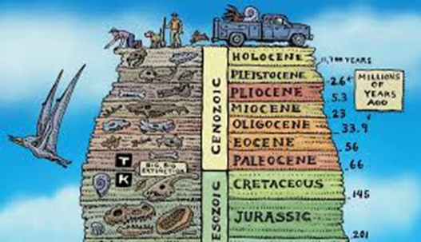
Conviction and Responsibility

Slide 7
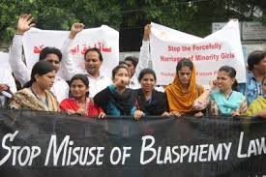
Rights and Tolerance

Slide 9
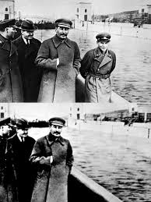
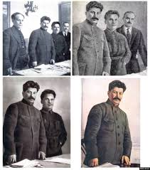
Ethics and Staging Events: is Fake News New?

Slide 10
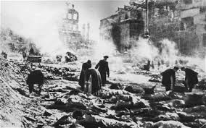
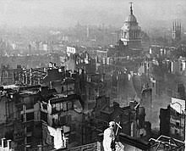
Ethics of War – Justice, Morality, Resentment

Slide 11
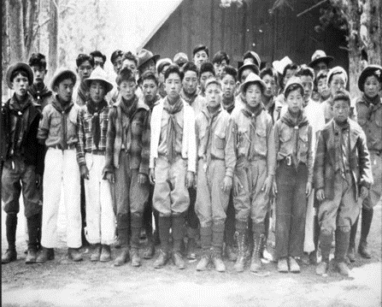
Ethics of War – Justice, Morality, Resentment

Slide 12
How to Write Poetry after Auschwitz?

Slide 13
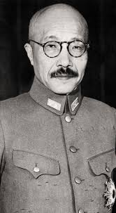
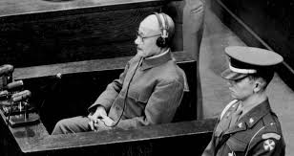
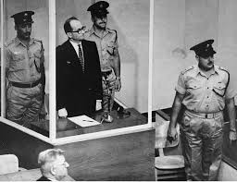
The Turning Points

Slide 14
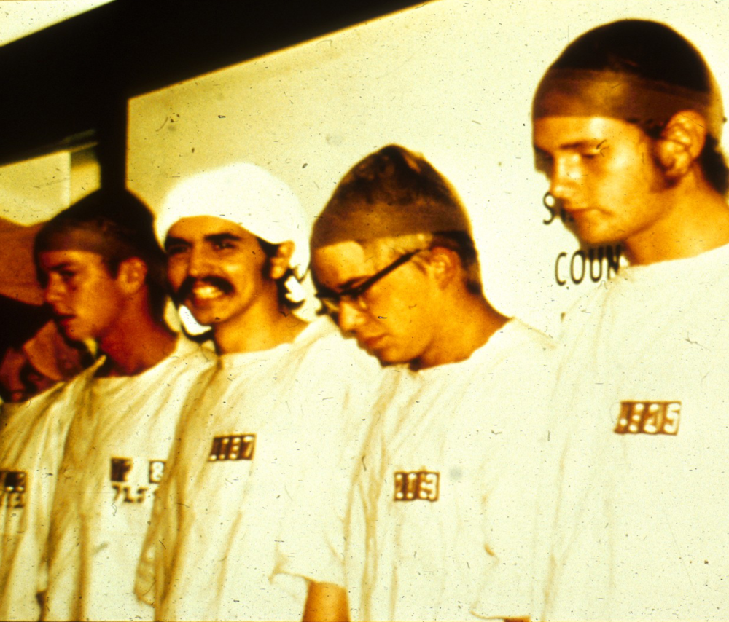
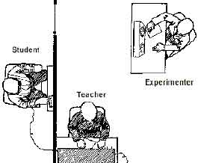
Eichmann, Zimbardo, Milgram

Slide 15
https://www.youtube.com/watch?v=PcEPFMEtLIo
https://www.youtube.com/watch?v=xOYLCy5PVgM

Slide 16
The Tuskegee Study of Untreated Syphilis in the Negro Male
This was an infamous, unethical, and malicious clinical study conducted between 1932 and 1972 by the U.S. Public Health Service. The purpose of this study was to observe the natural progression of untreated syphilis in rural African-American men in Alabama under the guise of receiving free health care from the United States government.[1] The study was conducted to understand the disease's natural history throughout time and to also determine proper treatment dosage for specific people and the best time to receive injections of treatment
https://www.youtube.com/watch?v=hpvYVc8pPuA

Slide 18
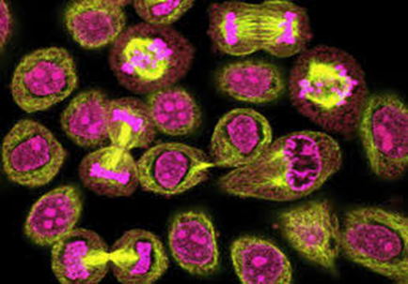
Henrietta Lacks and Her Immortal Cells

Slide 19
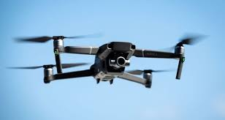
Ethics and Technology

Slide 20
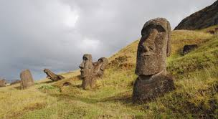
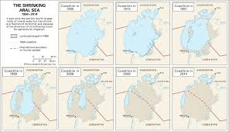
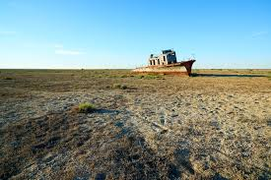
Ethics and Technology

Slide 21
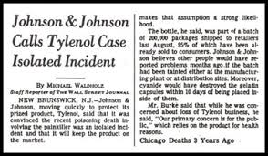
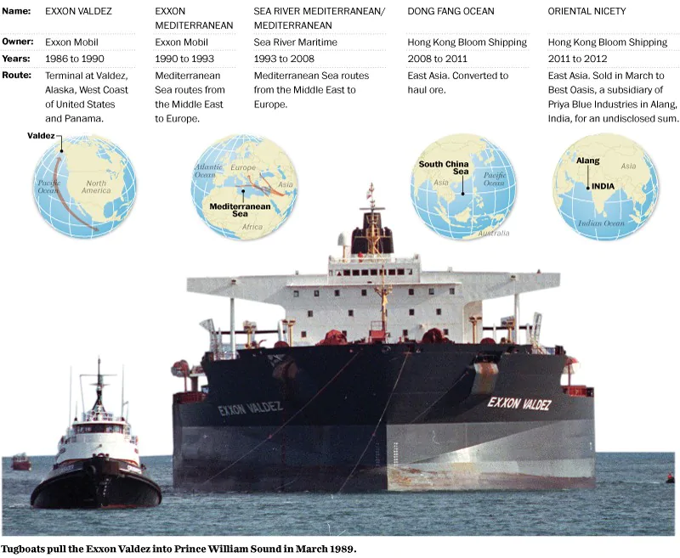
Historical Cases

Slide 22
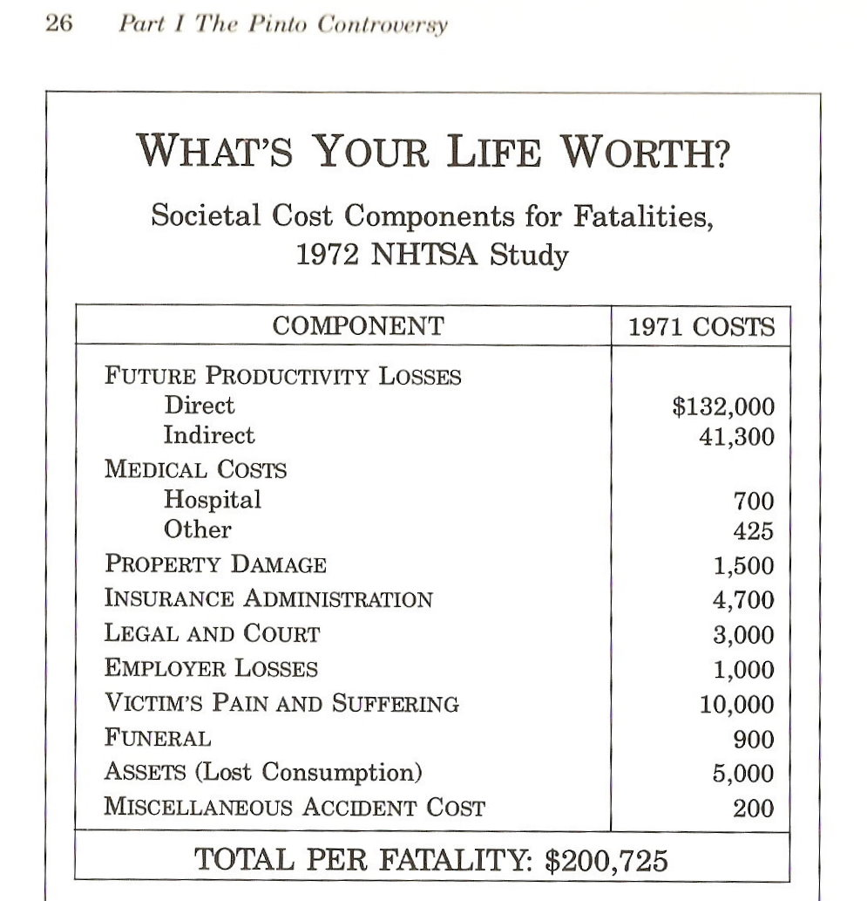
Calculating in Ethical Terms

Slide 23
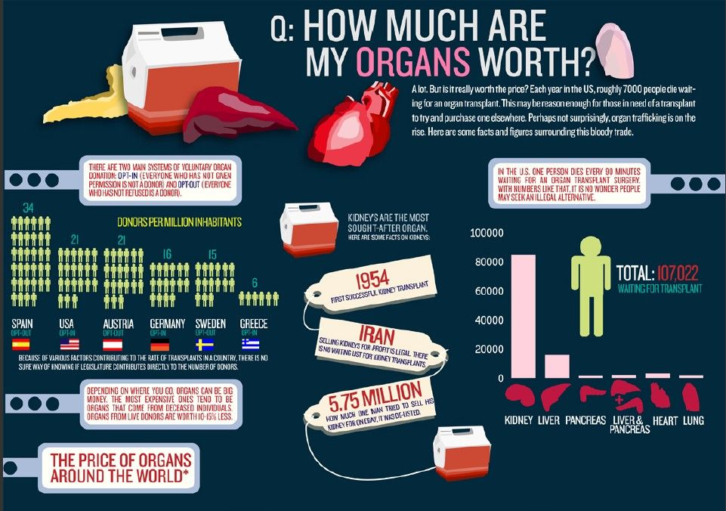
Values of Human Beings

Slide 24
Value of Human Composition

Slide 25
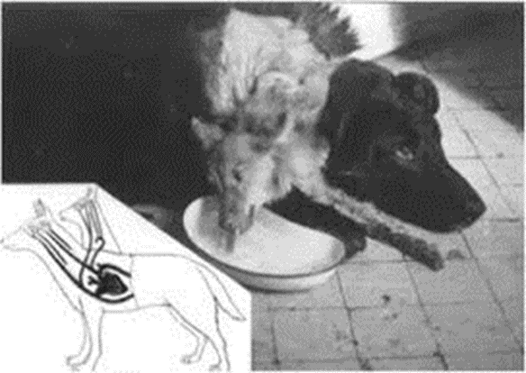
The Yuck Factor and the Wisdom of Repugnance

Slide 27
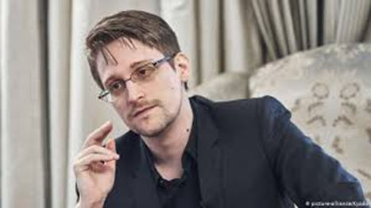
The Whistleblowers

Slide 28
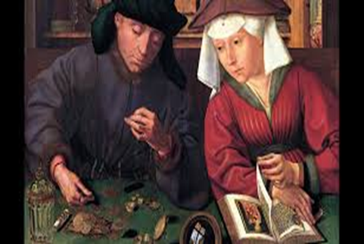
Usury and Capitalism

Slide 29
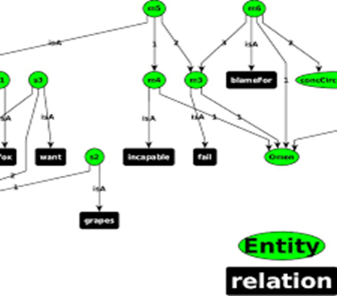
Sour Grapes and Rationalization

Slide 30
Hospitality, Trust, Distrust

Slide 31
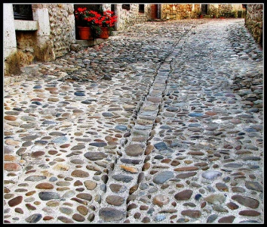
The Three Spit Parabola

Slide 32
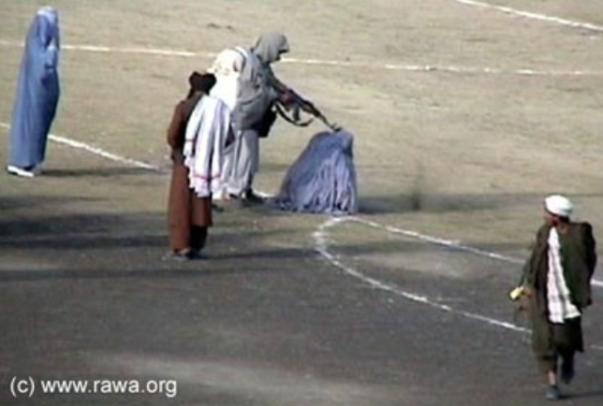
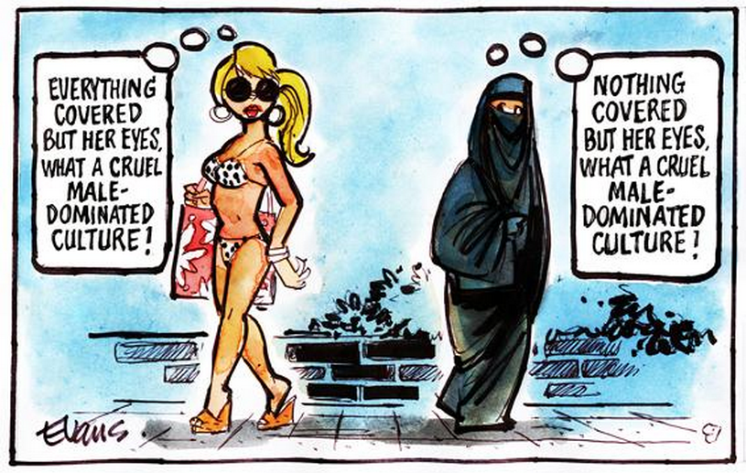
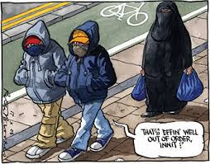
Ethical Relativism

Slide 34
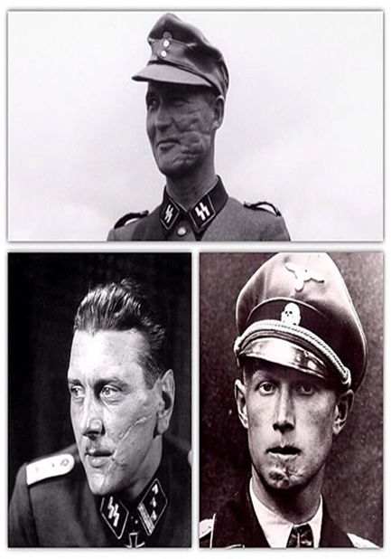
Mensur and Senses of Honor

Slide 36
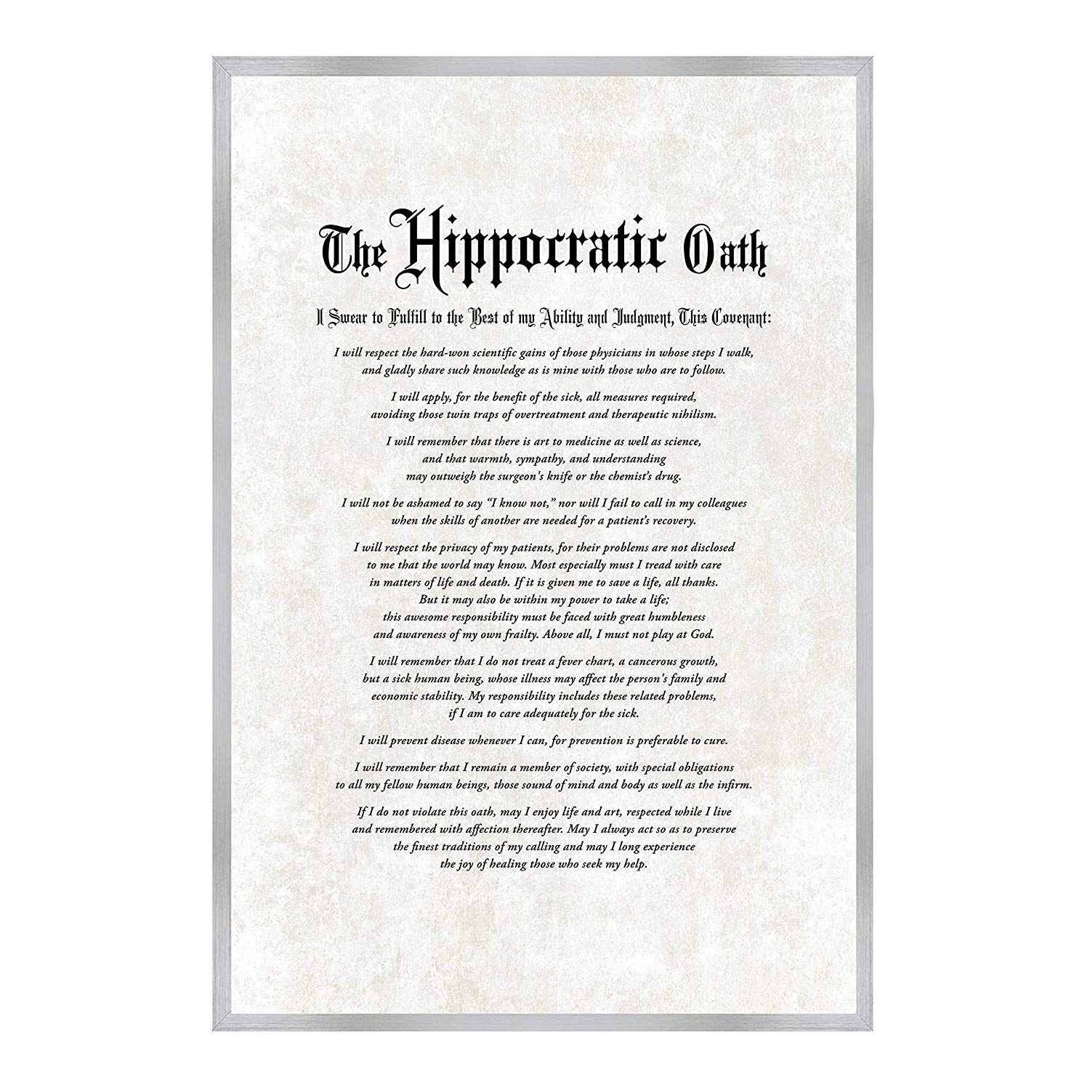
Oaths and Duties

Slide 38
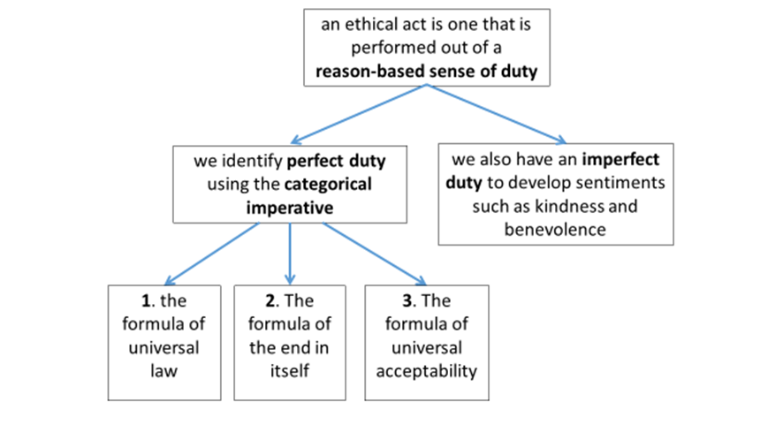

Slide 40
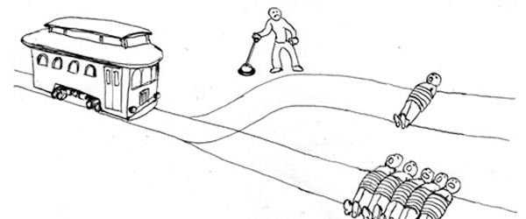
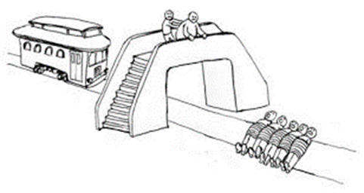
The Trolley Problem
https://www.youtube.com/watch?v=yg16u_bzjPE

Slide 41
Contestation on Markets

Slide 42
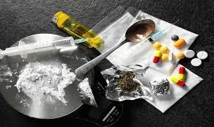
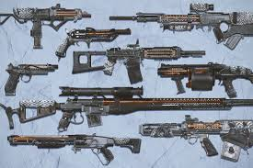
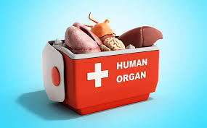
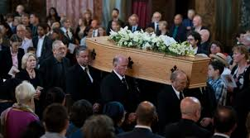
Contested Markets

Slide 43
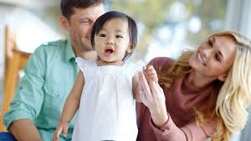
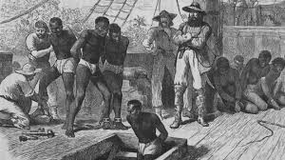
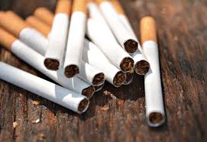
Contested Markets

